Slide 1
CS 252 Database Management Systems
Jan – May 2020
IV Semester
* Use the slides for reference only. Refer the text book for details.

Slide 2
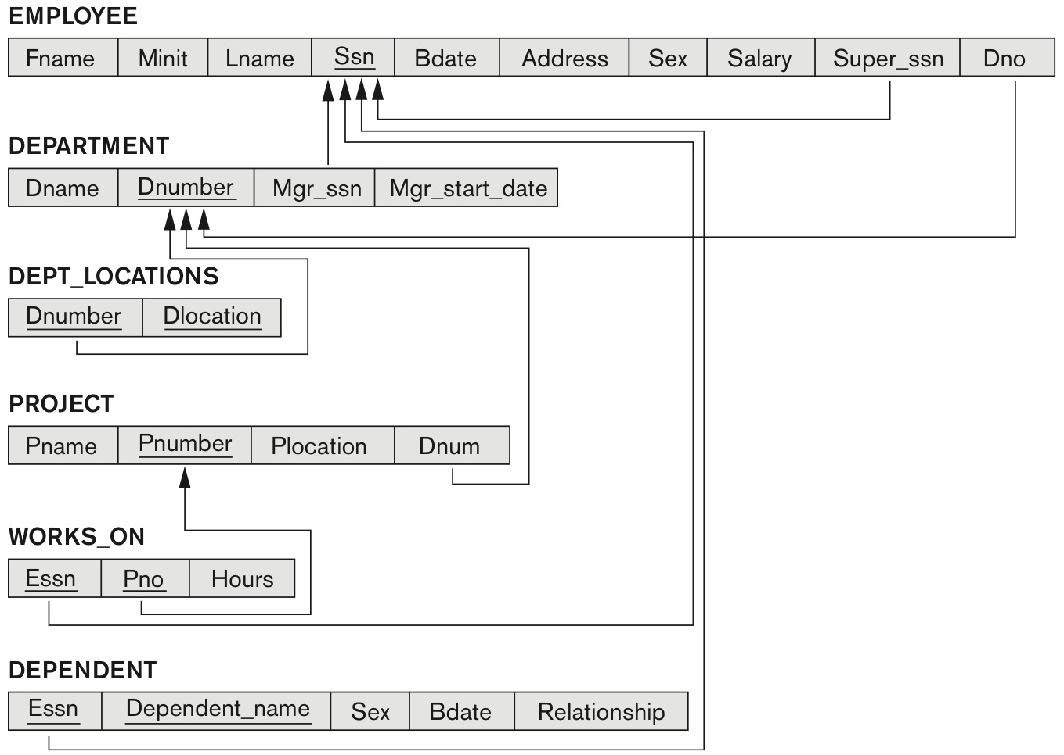
Company database – relational model

Slide 3
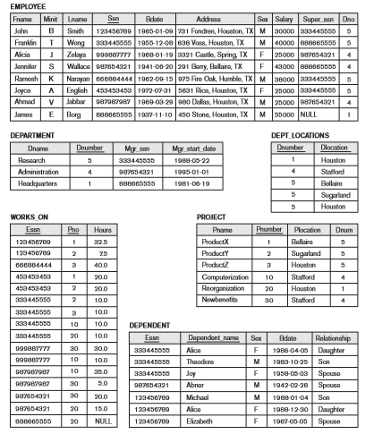
State of Company relational database schema

Slide 4
Substring Pattern Matching and Arithmetic Operators
LIKE comparison operator
Used for string pattern matching
% replaces an arbitrary number of zero or more characters
underscore (_) replaces a single character
Examples: WHERE Address LIKE ‘%Houston,TX%’;
WHERE Ssn LIKE ‘_ _ 1_ _ 8901’;
BETWEEN comparison operator
E.g.,
WHERE (Salary BETWEEN 30000 AND 40000)
AND Dno = 5;

Slide 5
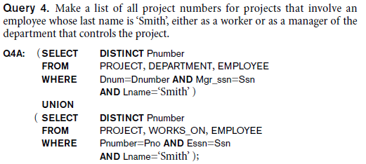
Set Operations
UNION, EXCEPT (difference), INTERSECT
Corresponding multiset operations: UNION ALL, EXCEPT ALL, INTERSECT ALL)
Type compatibility is needed for these operations to be valid

Slide 6
Nested Queries, Tuples and Set/Multiset Comparisons
Nested queries
Complete select-from-where blocks within WHERE clause of another query
Outer query and nested subqueries
Comparison operator IN
Compares value v with a set (or multiset) of values V
Evaluates to TRUE if v is one of the elements in V

Slide 7
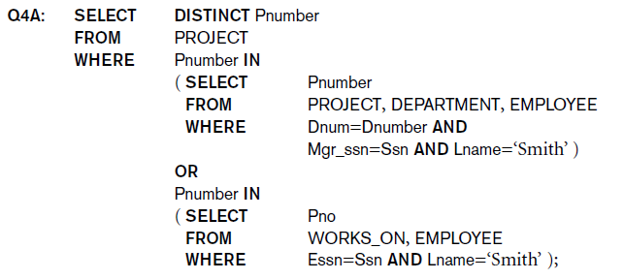
Nested Queries

Slide 8
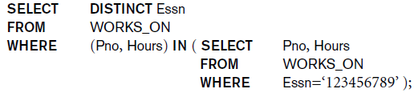
Nested Queries
Use tuples of values in comparisons
Place them within parentheses

Slide 9
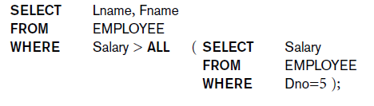
Nested Queries
Use other comparison operators to compare a single value v
= ANY (or = SOME) operator
Returns TRUE if the value v is equal to some value in the set V and is hence equivalent to IN
Other operators that can be combined with ANY (or SOME): >, >=, <, <=, and <>
ALL: value must exceed all values from nested query

Slide 10
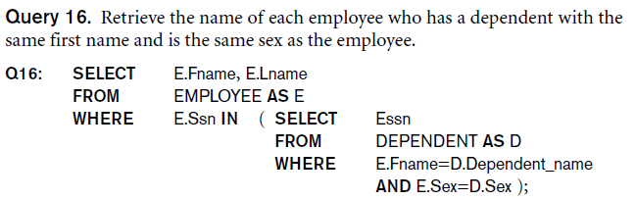
Nested Queries
Avoid potential errors and ambiguities
Create tuple variables (aliases) for all tables referenced in SQL query

Slide 11
Correlated Nested Queries
Queries that are nested using the = or IN comparison operator can be collapsed into one single block: E.g., Q16 can be written as:
Q16A: SELECT E.Fname, E.Lname
FROM EMPLOYEE AS E, DEPENDENT AS D
WHERE E.Ssn=D.Essn
AND E.Sex=D.Sex
AND E.Fname=D.Dependent_name;
Correlated nested query
Evaluated once for each tuple in the outer query

Slide 12
The EXISTS and UNIQUE Functions in SQL for correlating queries
EXISTS function
Check whether the result of a correlated nested query is empty or not. They are Boolean functions that return a TRUE or FALSE result.
EXISTS and NOT EXISTS
Typically used in conjunction with a correlated nested query
SQL function UNIQUE(Q)
Returns TRUE if there are no duplicate tuples in the result of query Q

Slide 13
USE of EXISTS
Q7:
SELECT Fname, Lname
FROM Employee
WHERE EXISTS (SELECT *
FROM DEPENDENT
WHERE Ssn= Essn)
AND EXISTS (SELECT *
FROM Department
WHERE Ssn= Mgr_Ssn)

Slide 14
USE OF NOT EXISTS
To achieve the “for all” effect, we use double negation this way in SQL:
Query: List first and last name of employees who work on ALL projects controlled by Dno=5.
SELECT Fname, Lname
FROM Employee
WHERE NOT EXISTS ( (SELECT Pnumber
FROM PROJECT
WHERE Dno=5)
EXCEPT (SELECT Pno
FROM WORKS_ON
WHERE Ssn= ESsn)
The above is equivalent to double negation: List names of those employees for whom there does NOT exist a project managed by department no. 5 that they do NOT work on.

Slide 15

Explicit Sets and Renaming of Attributes in SQL
Can use explicit set of values in WHERE clause
Q17: SELECT DISTINCT Essn
FROM WORKS_ON
WHERE Pno IN (1, 2, 3);
Use qualifier AS followed by desired new name
Rename any attribute that appears in the result of a query

Slide 16

Specifying Joined Tables in the FROM Clause of SQL
Joined table
Permits users to specify a table resulting from a join operation in the FROM clause of a query
The FROM clause in Q1A
Contains a single joined table. JOIN may also be called INNER JOIN

Slide 17
NATURAL JOIN
Rename attributes of one relation so it can be joined with another using NATURAL JOIN:
Q1B: SELECT Fname, Lname, Address
FROM (EMPLOYEE NATURAL JOIN
(DEPARTMENT AS DEPT (Dname, Dno, Mssn, Msdate)))
WHERE Dname=‘Research’;
The above works with EMPLOYEE.Dno = DEPT.Dno as an implicit join condition

Slide 18
Example: LEFT OUTER JOIN
SELECT E.Lname AS Employee_Name
S.Lname AS Supervisor_Name
FROM Employee AS E LEFT OUTER JOIN EMPLOYEE AS S
ON E.Super_ssn = S.Ssn)
ALTERNATE SYNTAX:
SELECT E.Lname , S.Lname
FROM EMPLOYEE E, EMPLOYEE S
WHERE E.Super_ssn + = S.Ssn

Slide 19
Multiway JOIN in the FROM clause
FULL OUTER JOIN – combines result if LEFT and RIGHT OUTER JOIN
Can nest JOIN specifications for a multiway join:
Q2A: SELECT Pnumber, Dnum, Lname, Address, Bdate
FROM ((PROJECT JOIN DEPARTMENT ON Dnum=Dnumber)
JOIN EMPLOYEE ON Mgr_ssn=Ssn)
WHERE Plocation=‘Stafford’;

Slide 20
Use of WITH
The WITH clause allows a user to define a table that will only be used in a particular query (not available in all SQL implementations)
Used for convenience to create a temporary “View” and use that immediately in a query
Allows a more straightforward way of looking a step-by-step query

Slide 21
Example of WITH
See an alternate approach to doing Q28:
Q28’: WITH BIGDEPTS (Dno) AS
( SELECT Dno
FROM EMPLOYEE
GROUP BY Dno
HAVING COUNT (*) > 5)
SELECT Dno, COUNT (*)
FROM EMPLOYEE
WHERE Salary>40000 AND Dno IN BIGDEPTS
GROUP BY Dno;

Slide 22
Use of CASE
SQL also has a CASE construct
Used when a value can be different based on certain conditions.
Can be used in any part of an SQL query where a value is expected
Applicable when querying, inserting or updating tuples

Slide 23
EXAMPLE of use of CASE
The following example shows that employees are receiving different raises in different departments (A variation of the update U6)
U6’: UPDATE EMPLOYEE
SET Salary =
CASE WHEN Dno = 5 THEN Salary + 2000
WHEN Dno = 4 THEN Salary + 1500
WHEN Dno = 1 THEN Salary + 3000
END;

Slide 24
An EXAMPLE of RECURSIVE Query
Q29: WITH RECURSIVE SUP_EMP (SupSsn, EmpSsn) AS
SELECT SupervisorSsn, Ssn
FROM EMPLOYEE
UNION
SELECT E.Ssn, S.SupSsn
FROM EMPLOYEE AS E, SUP_EMP AS S
WHERE E.SupervisorSsn = S.EmpSsn)
SELECT *
FROM SUP_EMP;
The above query starts with an empty SUP_EMP and successively builds SUP_EMP table by computing immediate supervisees first, then second level supervisees, etc. until a fixed point is reached and no more supervisees can be added

